Slide 1
DIC IIT BHU - PRESENTATION
DR ASHISH AGRAWAL
ASSISTANT PROFESSOR
FACULTY OF DENTAL SCIENCES
IMS BHU

Slide 2
AIMS AND OBJECTIVE
TO DESIGN A ELECTRONIC DEVICE OF DIMENTION 7 X 7 MM OR LESS WHICH CAN BE PLACED INTRA ORALLY AND CAN DELIVER A DC CURRENT OF VARIBLE MICRO AMPERE AND CAN ALSO BE ABLE TO DELIVER VARIABLE FEQUENCY/ WAVE FORM
    TO STUDY THE BIOCHEMICAL (1) ALTERATION IN THE IMMEDIATE VICINITY OF THE TOOTH / IMPLANT AS COMPAIRE TO THE CONTROLL
TO STUDY THE EFFECT OF ELECTRICAL IMPLUSES OF PHYSCIOLOGICAL LIMIT ON BONE TRUNOVER (RESORBTION AND DEPOSITION) TO POTENTIATE THE EFFECT OF DC CURRENT ON HUMAN BONE EITHER BY STUDYING :
    THE RATE OF TOOTH MOVEMENT ON APPLICATION OF A DEFINITIVE FORCE
              OR
    THE AMOUNT OF BONE LOSS/DEPOSITION IN THECRESTAL REGION OF PROSTHETIC IMPLANT WITH 6 MONTHS OF SURGICAL PLACEMENT
1. ROBERT H. CHRISTENSON : BIOCHEMICAL MARKERS OF BONE METABOLISUM: AN OVERVIEW; CLINICAL BIOCHEMISTRY, VOL 30, NO. 8, 573-593, 1997

Slide 3
DESIGN AND INNOVATIVE APPROACH
THERE HAS BEEN VARIOUS EXPERIMENTS DONE ON ANIMALS (2, 3) ON BONE TURN OVER BUT THERE HAS NO SCIENTIFIC STUDY DONE AND REPORTED IN LITRATURE TILL DATE IN HUMAN BEEINGS.
THERE HAS BEEN NO ELECTRICAL DEVICE MADE WHICH CAN ALTER THE BONE TUROVER IN HUMAN BEEING AS DOCUMENTED TILL DATE.
2. ZEEV DAVIDOVITCH ET AL. ELECTRIC CURRENT , BONE REMODELLING & ORTHODONTIC TOOTH MOVEMENT ; AJODO VOLUME 1980 JAN (33-47)
3. SILVIA RODRIGUES DE ALBUQUERQUE ET AL. EXPERIMENTAL MODEL OF TOOTH ,MOVEMENT IN MICE : A STANDARDLIZED PROTOCOL FOR STUDYING BONE REMODELLING ; JOURNAL OF BIOMECHANICS 45 (201202729-2735

Slide 4
METHODOLOGY
CRITERIA OF SELECTION OF PATIENTS
THE PATIENT SHOULD BE IN NEED OF ORTHODONTIC TREATMENT
NO PRECIOUS HISTORY OF ORTHODONTIC TREATMENT
PATIENT SELECTED SDHOULD BE ADULT IN WHOM GROWTH HAS COMPLETE - AGE RANGE OF 18 – 26 YEARS
NO MISSING TEETH OR IMPACTED IN THE ARCHES
No of subjects to be taken will depend the available budget and on statistical basis.

Slide 5
METHODOLOGY
Experiment and control:
Intra orally – one side of the same patient will act as control and the other side of the same arch will be experimental side
Ct scan images will have to be taken to justify the bone density of the region in order to standardise the procedure.

Slide 6
METHODOLOGY
Material :
Dontrix gauge
Digital virnear caliper
Lateral cephalogram
Ct scan images
Electronic chip
Orthodontic materials for treatment procedure such as – Niti coil springs, coated wires , coated ligature wires, ceramic brackets with buccal tubes

Slide 7
METHODOLOGY
METHOD:
Phase I: (6- 8 months)
Manufacturing of electrical device of 7 x 7 mm which has the capability to deliver current in the rang of 10 – 2- micro ampere
The device should also deliver a square wave form of varying time interval
Covering the electronic chip with bio acrylic material to make it saliva protected
Acquiring dental unit so that the patient can be put on braces - alignment and levelling is done by the time the chip is prepared – approx 4months months to finish alignment and levelling

Slide 8
METHODOLOGY
Phase II: (6 – 8 months)
a. After initial alignment and levelling has been done canine retraction be initiated with a standard delivering NITI coil springs.
b. Reading be noted with the help of vernear calliper
c. Biochemical analysis to be done simultaneously.
TOTAL TIME PERIOD REQUIRED = 1.6 YEARS APPROX

Slide 9
BUDJECT JUSTIFICATION
SERIAL NUMBER | MATERIAL | APPROXIMATE COST | REASON
1. | FABRICATION OF MICRO ELECTRONIC DEVICE: | 3,00,000/- | VARIOUS MICRO ELECTRONIC COMPONENTS AND CHIP. The chip cant be made in the electronic department IIT BHU – OUT SOURCING
2. | DENTAL UNIT | 1,40,000/- | THE DEPARTMENT DOESN’T HAVE SUFFICIENT dental UNIT TO WORK ON , AS THERE 9 POSTGRADUATE AND 8 WORKING UNITS WHICH IS SCARCE EVEN FOR POSTGRADUATES. DENTAL UNITS ARE NESSARY FOR ANY CLINICAL TRAIL

Slide 10
3. | ELISA KIT (R) –(1) | 25,000/- | BIOCHEMICAL MARKER
4. | ELISA KIT (O) – (1) | 25,000/- | BIOCHEMICAL MARKER
5. | MICRO PIPPETS (8) | 32,000/- | COLLECTION OF MICRO LETER OF FLUID
6. | COATED WIRES SS | 5000/- | INSULATED ORTHODONTIC WIRES TO USED ALONG WITH THE ELECTRONIC DEVICE DURING TREAMTMENT - NOT AVAILABLE IN DEPARTMENT
7. | COATED LIGATURE | 3000/- | INSULATED ORTHODONTIC LIGATURE WIRES TO BE USED FOR TIEING COATED WIRES WITH BRACKETS - NOT AVAILABLE IN DEPARTMENT

Slide 11
8. | DONTRIX GAUGE | 4000/- | MEASUREMENT DEVICE TO ASSESS THE FORCE APPLIED FOR DESIRED TOOTH MOVEMENT – NOT AVAILABLE IN DEPARTMENT
9. | ORTHODONTIC PLIERS | 40,000/- | BASIC INSTRUMENT NEEDED TO TREAT PATIENTS WITH ELECTRONIC DEVICE ATTACHED INTRA ORALLY – NOT AVAILABLE IN DEPARTMENT
10 | TRAVELLING AND MISCELLANEOUS | 30,000/- | 7 X7 MM INTRA ORAL (MICRO ELECTRONIC DEVICE) CANT BE MADE IN IIT BHU – OUT SOURCING
Total cost = 6,04,000/-

Slide 12
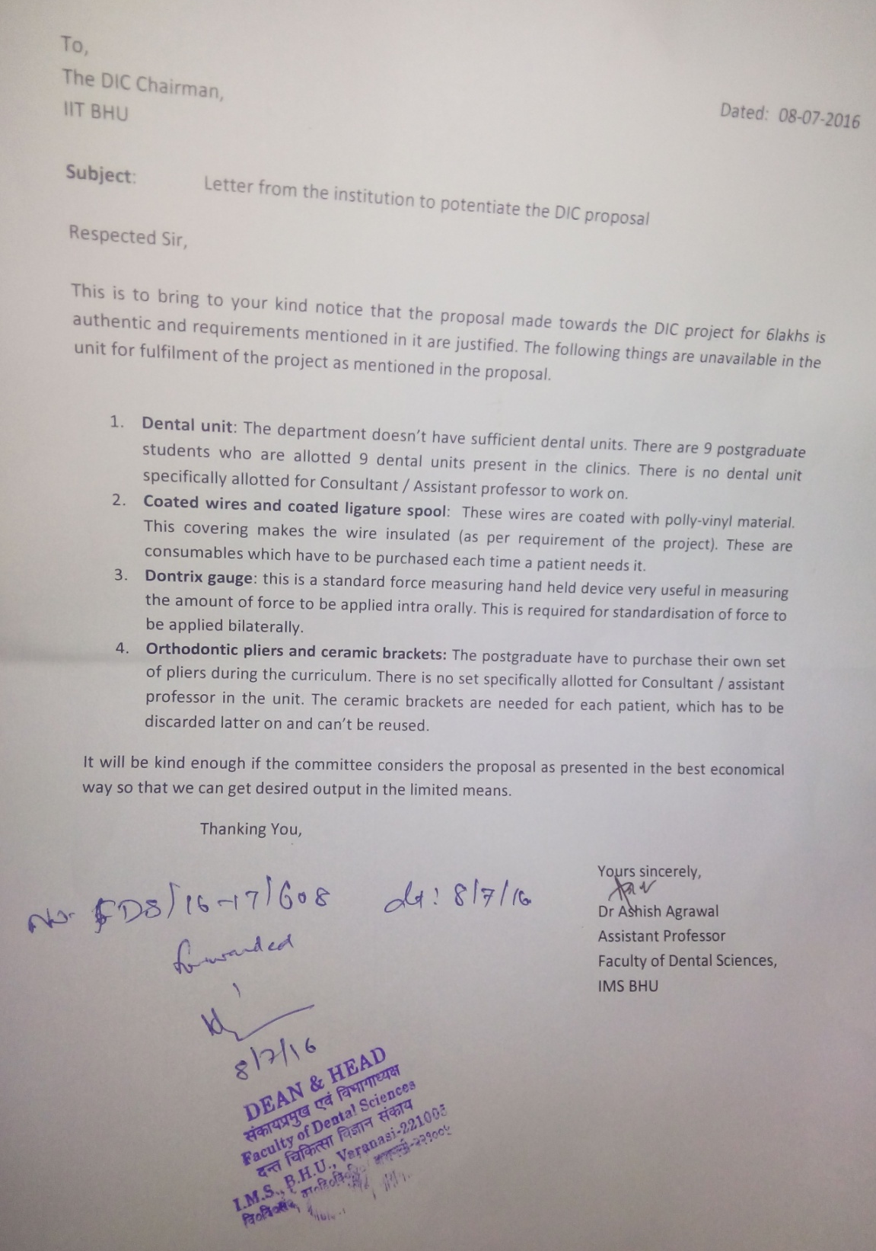
Endorsement letter from dean and head dental sciences stating the proposal made is authentic and deficiencies mentioned are genuine

Slide 13
FUTURE
Detailed study of bone remodelling and biochemical changes through application of electrical stimulation can bring about bone remodelling ,bone healing , bone growth as desired even at location away from oral cavity
Might be helpful in early repair of fracture of bone
Reduction of time period of not only orthodontic patients sue to faster turn over of bone but will also be boon for orthopaedics for various bone remodelling procedures

