Slide 1
Designing a cell based prototype for the high throughput screening of cancer drugs
Research proposal for Design and Innovation center
Subash Chandra Gupta, Ph.D.
Assistant Professor
Department of Biochemistry, Institute of Science
Banaras Hindu University, Varanasi, India

Slide 2
What and Why
Only one of every 5,000 to 10,000 prospective anti-cancer agents receives FDA approval.
Only 5% of oncology drugs entering phase I clinical trials are ultimately approved by FDA.
Most of the currently available cancer drugs are highly expensive, provide minimal increase in the overall survival and are associated with numerous side effects.
An alternative method for the cancer drug development is required.

Slide 3
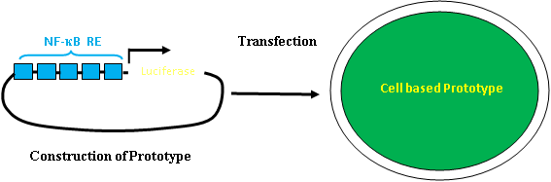
Methodology
Cells expressing NF-κB reporter
TNF-α (12 hrs)
Prospective anti-cancer agents
NF-κB reporter activity
The 5 copies of NF-κB response elements (5 x NF-κB-RE) in front of minimal promoter (TATA) and luciferase gene will be introduced into an expression vector.
The construct will be introduced into the cells that will serve as a prototype.
The prototype will be used for the screening of prospective anti-cancer agents.

Slide 4
Budget with justification
Sl. No. | Requirement | Estimated cost (INR) | Justification
1 | Laminar flow hood | 100,000.00 | The project involves extensive use of cell lines harbouring NF-kB construct. The laminar flow hood will be required to culture the cell lines in extremely aseptic conditions.
2 | Water bath | 75,000.00 | The project involves extensive use of cell culture. Water bath will be required for the routine preparation of media.
3 | Liquid nitrogen container | 1,00,000.00 | This will be required for the storage of precious cell lines.
4 | CO₂ cylinder | 25,000.00 | This will be required for maintaining cell line culture.
5 | Consumables | 1,50,000.00 | The project involves extensive use of RNA, DNA and protein work. The consumables are required to successfully complete the project.
6 | Contingency | 50,000.00 | The amount will be utilized for the purchase of stationary and to meet the expenses of instrumental services. The amount will also be utilized for local purchases of materials.
 | Grand total | 5,00,000.00

Slide 5
Duration
One year from the date of receiving the fund.

Slide 6
Deliverable
Development of novel drugs of natural origin is expected that will help for the prevention and treatment of cancer.
The prototype will help to expedite the process of drug development process.
The prototype will greatly help in reducing the cost associated with the cancer drug development process.

