Slide 1
Project: A Prototype Bioreactor for Kitchen Waste Disposal
(Progress Report)
December 2016

Slide 2
Mass culture of Cellulose degrading bacteria :
Cellulose degrading bacterial strain 1 (CDB1) was mass cultured in CMC medium.
2 l CMC media was prepared and CDB strain was inoculated and was kept for incubation in orbital shaker incubator at 37˚c for 3 days.
After that the mass cultured cells of CDB strain 1 were extracted by centrifugation at 5000rpm.
Then the culture for lyophilized in order to gain bacteria in lyophilized powder form.

Slide 3
Analysing the activity of lyophilized cellulose degrading bacteria (CDB-1) on vegetable waste:
Total 7 beakers were taken and marked in the order from 1st to 7th.
In all the beakers 200gm vegetable waste was inoculated in each.
Then all the beakers containing vegetable waste was surface sterilized by keeping it in oven at 80˚c for 10 min.
In 1 beaker no lyophilized bacteria was inoculated. While in 2nd, 3rd, 4th, beaker 1gm each lyophilized bacteria was inoculated.
In remaining 5th, 6th, 7th beaker 2gm, 3gm, 4 gm lyophilized bacteria was inoculated respectively.
After that all the beakers where covered with aluminium foil except 2nd beaker.
While in 3rd beaker holes were made in aluminium foil for aeration.
After that all beaker were kept in biofermenter.
Then the degrading activity of the vegetable waste was observed after each day.

Slide 4
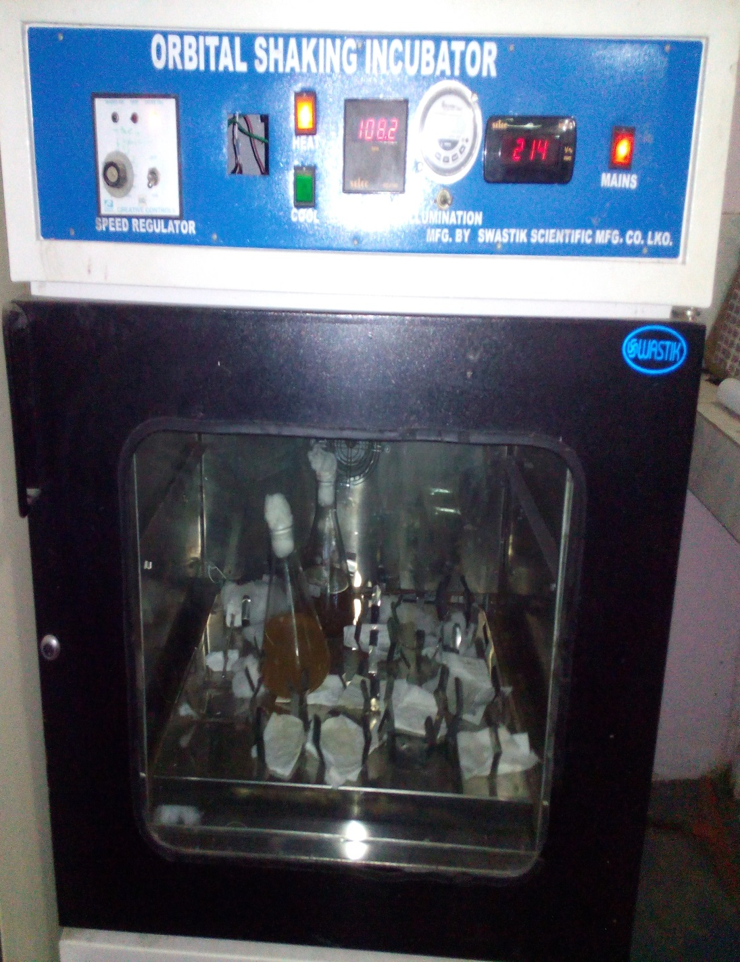
Bacteria for mass culture was incubated in Orbital shaking incubator.

Slide 5
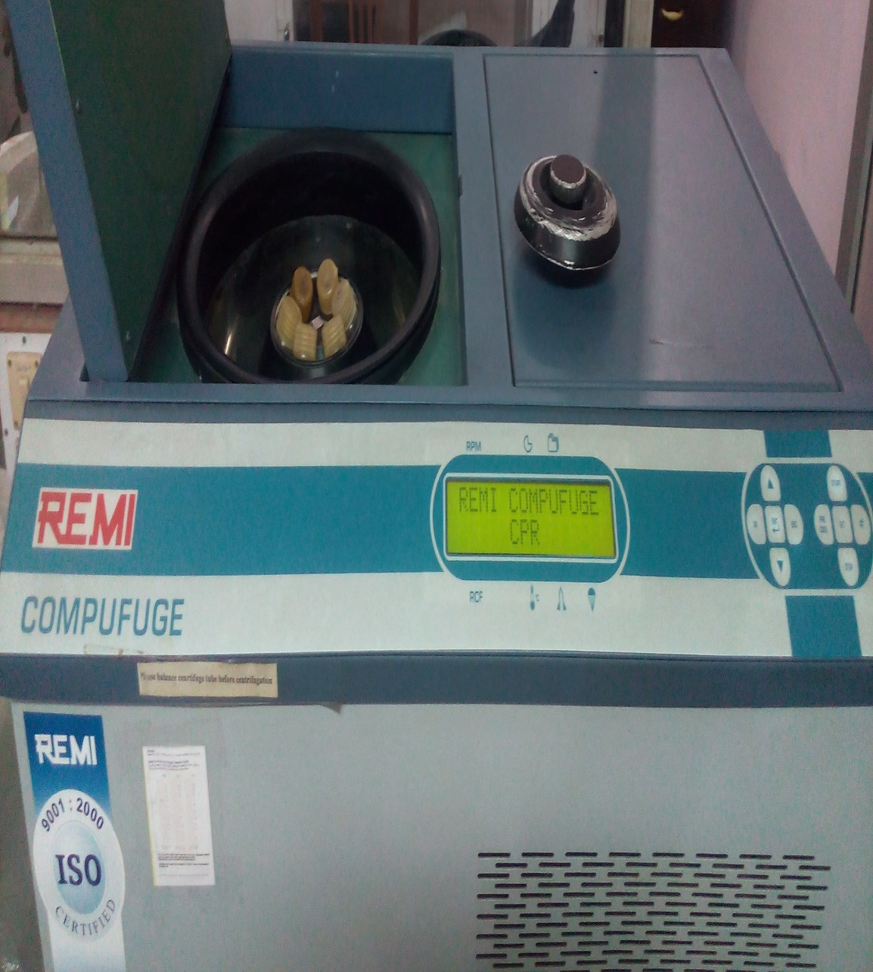
Cellulose Degrading Bacteria was centrifuged using centrifuge machine

Slide 6
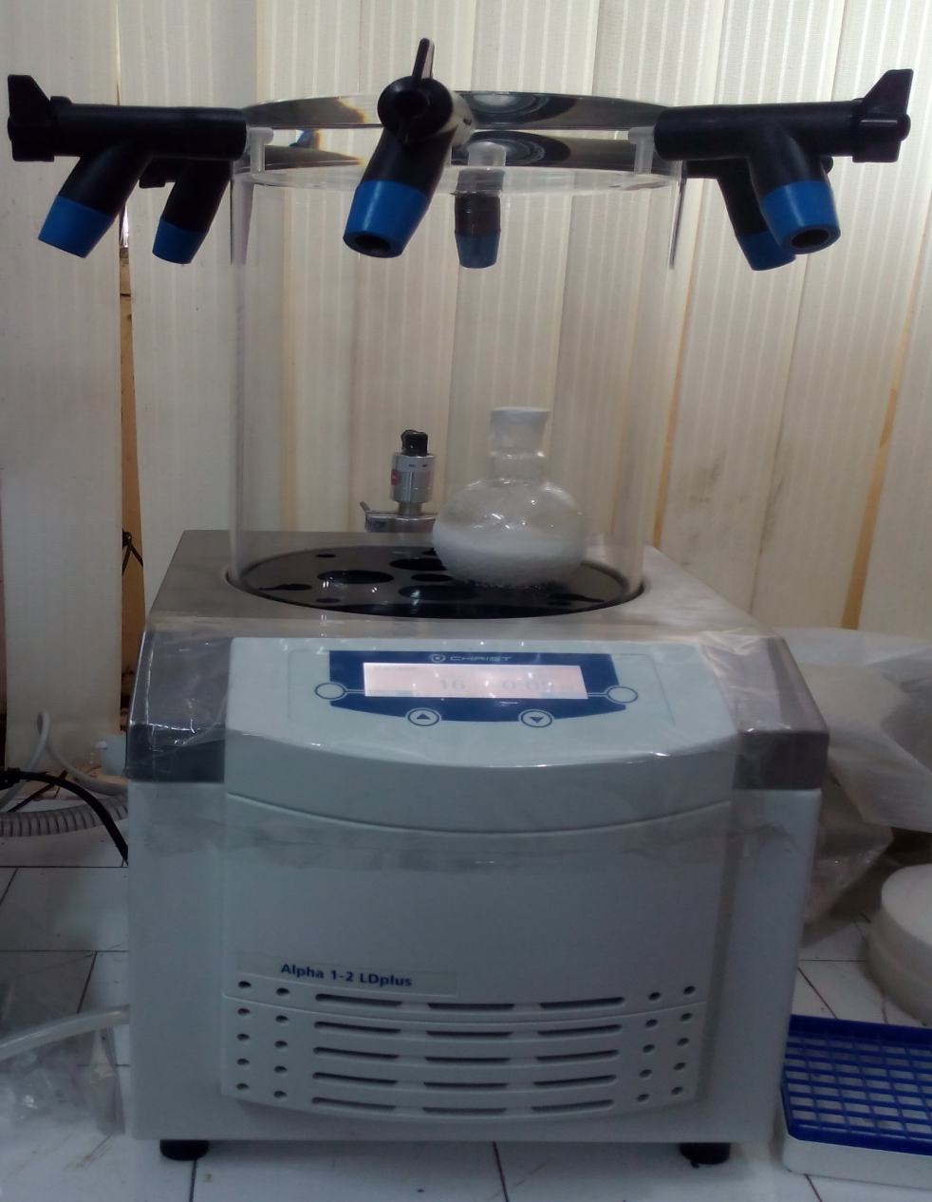
Cellulose Degrading Bacteria was lyophilized using centrifuge machine

Slide 7
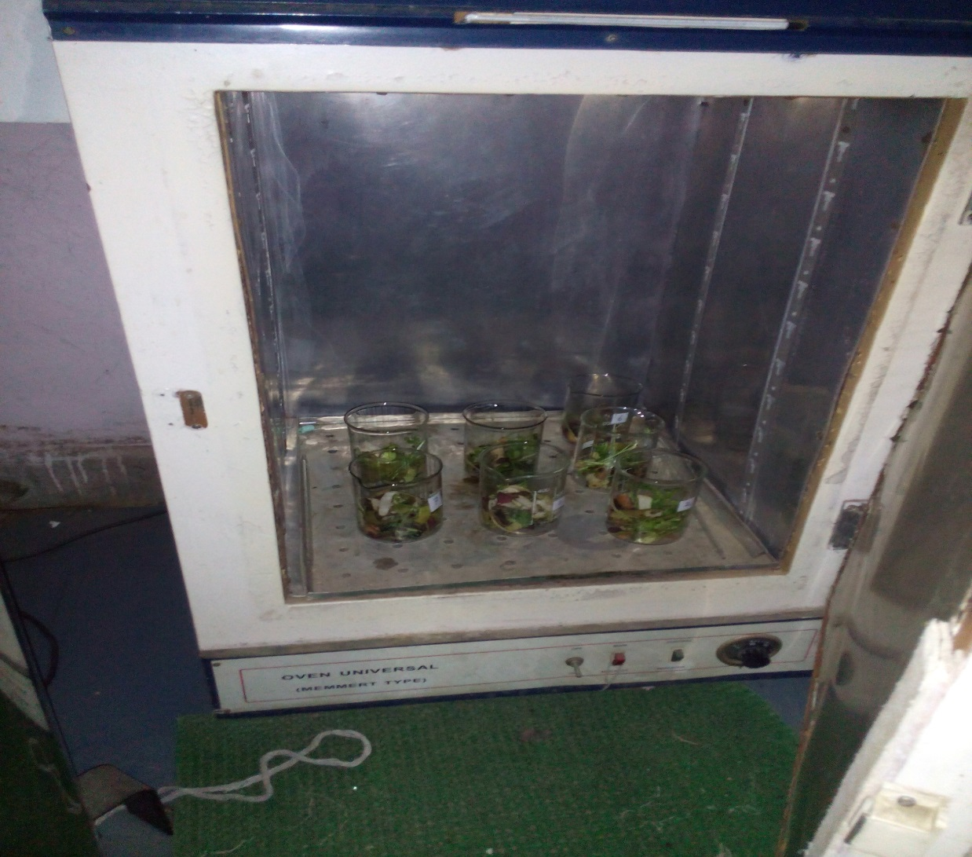
Observation for analysing the activity of lyophilized cellulose degrading bacteria (CDB-1) on vegetable waste:
Vegetable waste was sterilized in oven at 80˚c for 10 min before inoculation of Bacteria.

Slide 8
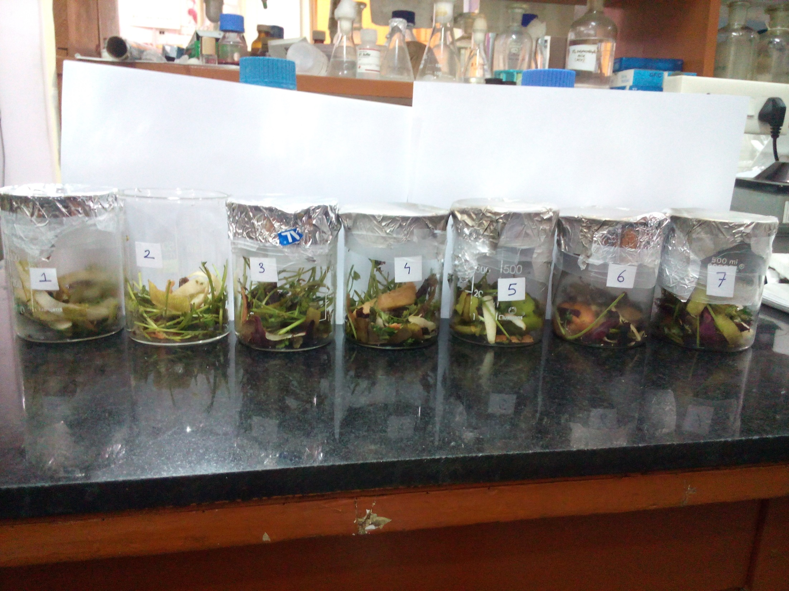
1
No bacteria was inoculated
2
1 gm bacteria was inoculated and not covered with aluminium foil.
3
1 gm Bacteria was inoculated and holes were made in aluminium foil for aeration.
4
1gm bacteria was inoculated in vegetable waste.

Slide 9
5
2gm lyophilized bacterial powder was inoculated in vegetable waste.
6
3gm lyophilized bacterial powder was inoculated in vegetable waste.
7
4gm lyophilized bacterial powder was inoculated in vegetable waste.

Slide 10
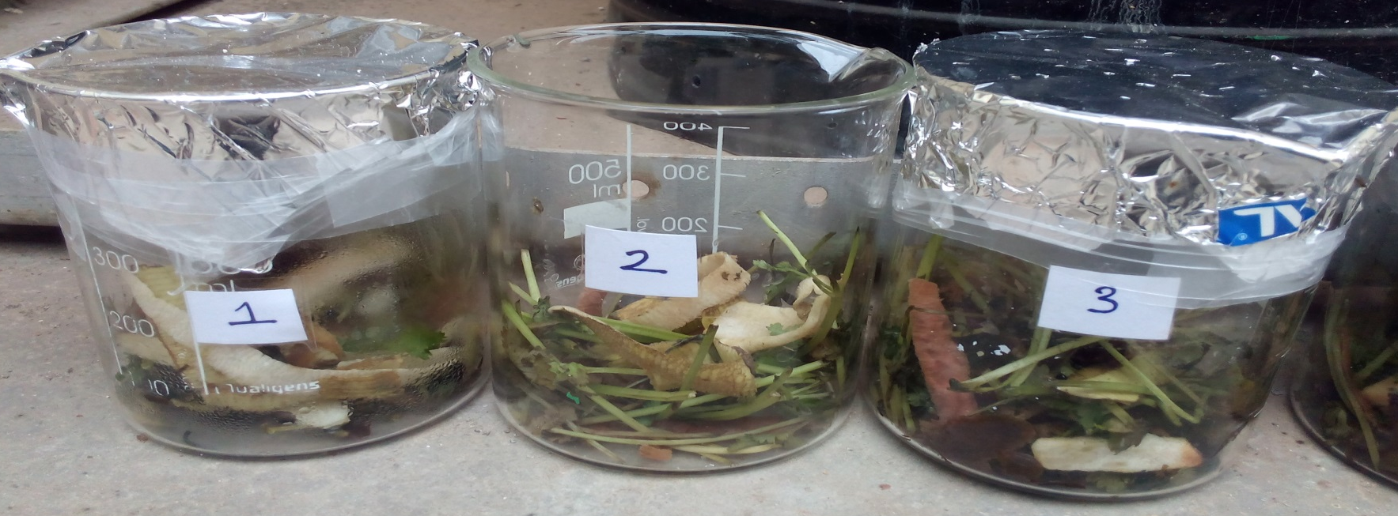
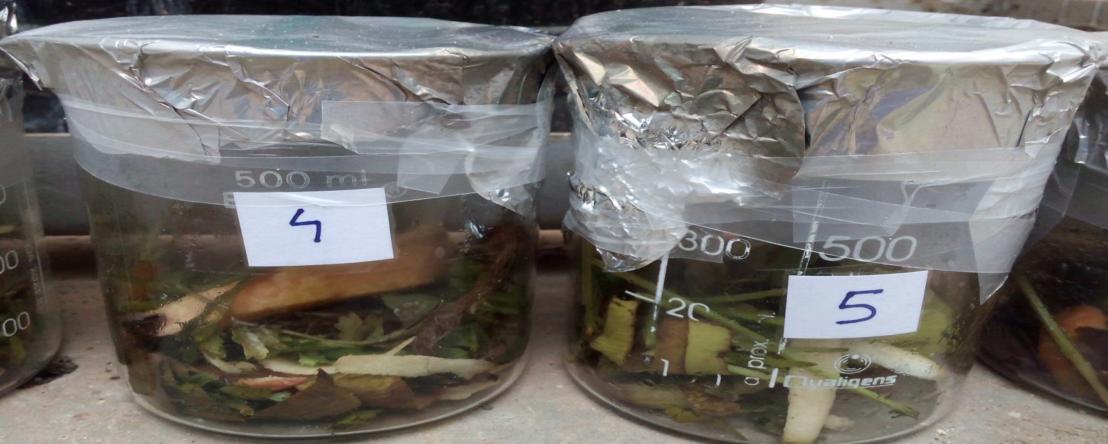
Waste observed after 2 days of inoculation of CDB1:

Slide 11
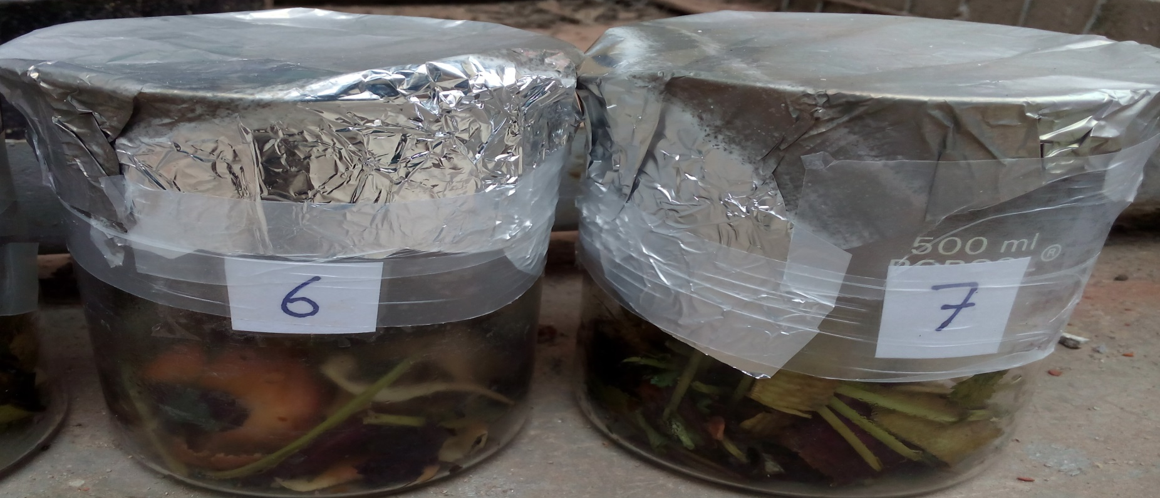

Slide 12
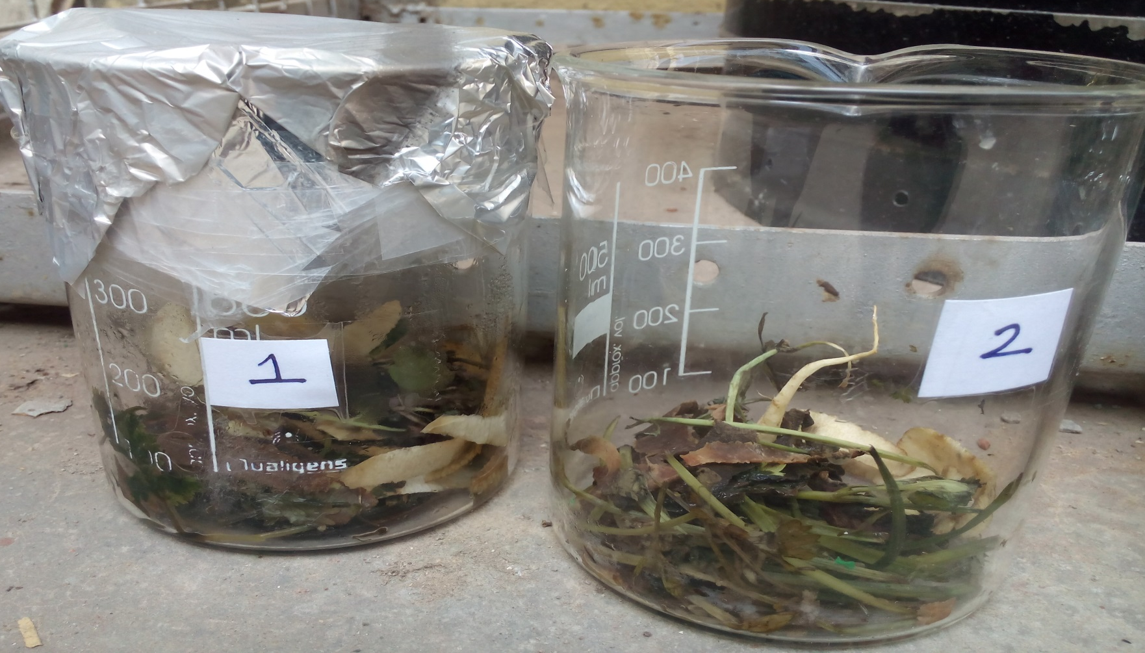
Waste observed after 5 days of inoculation of CDB1:

Slide 13
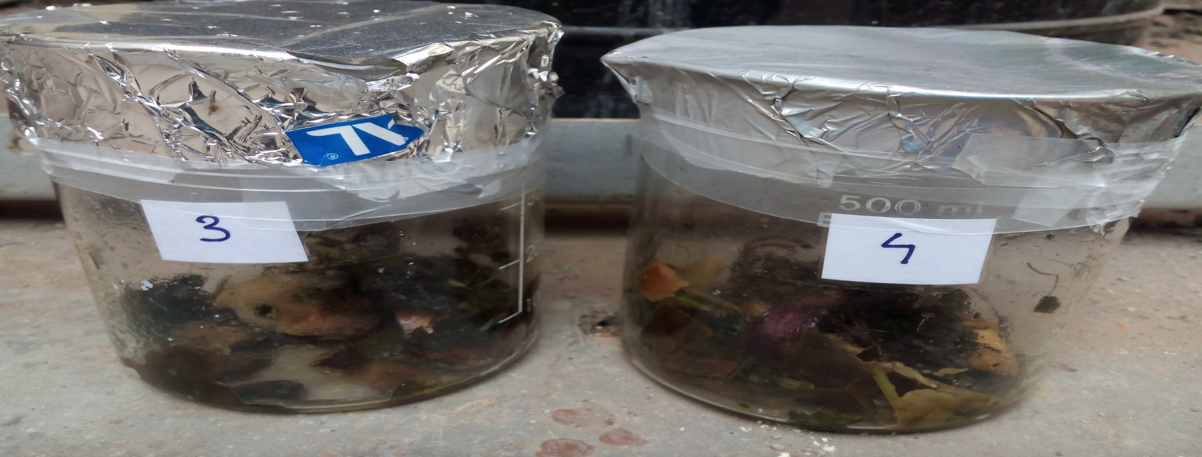
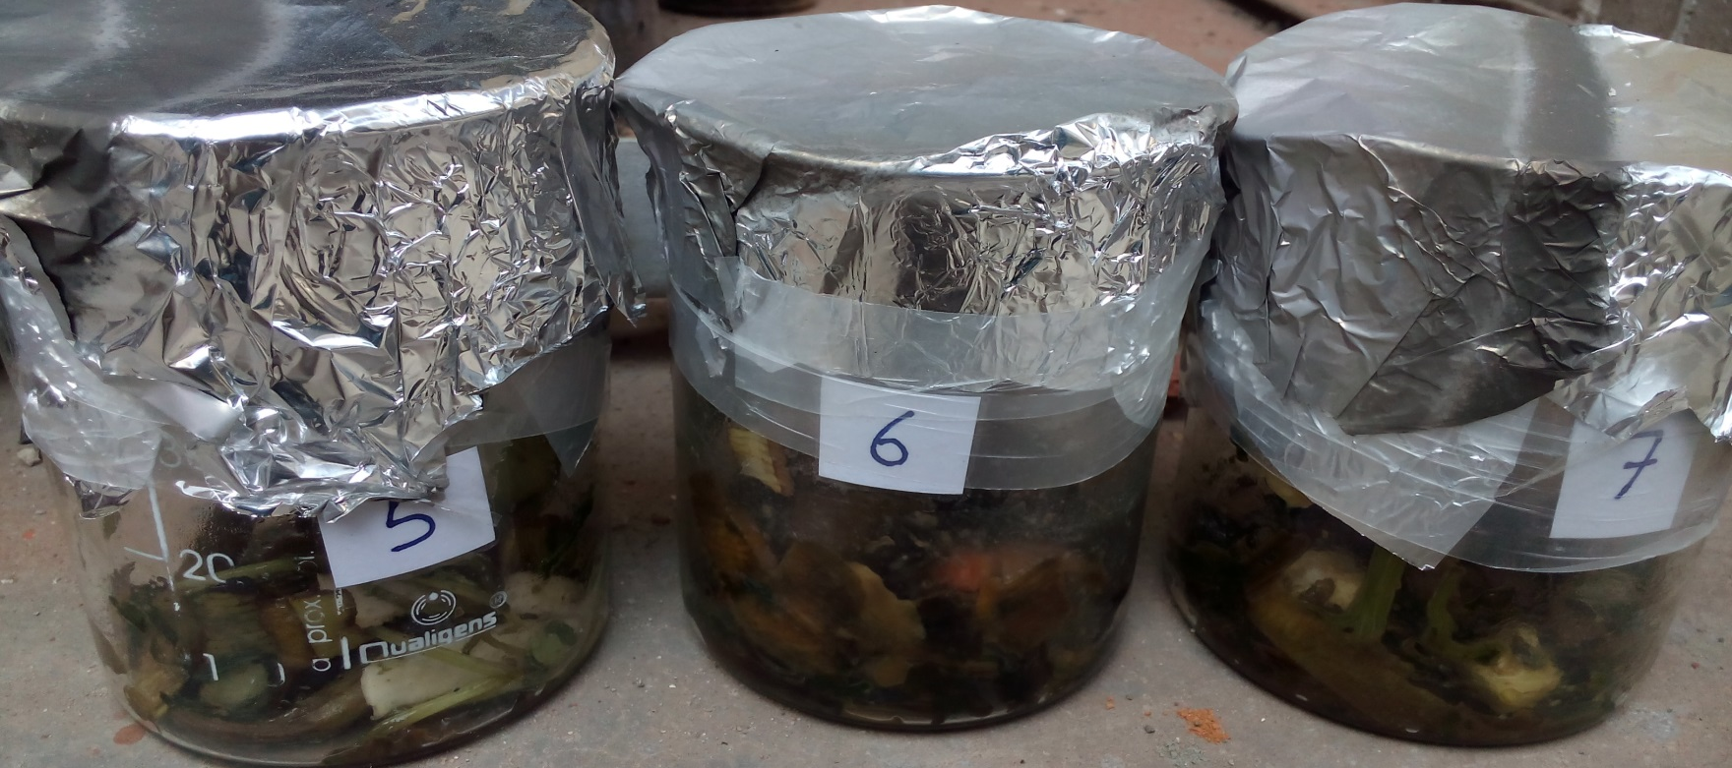

Slide 14
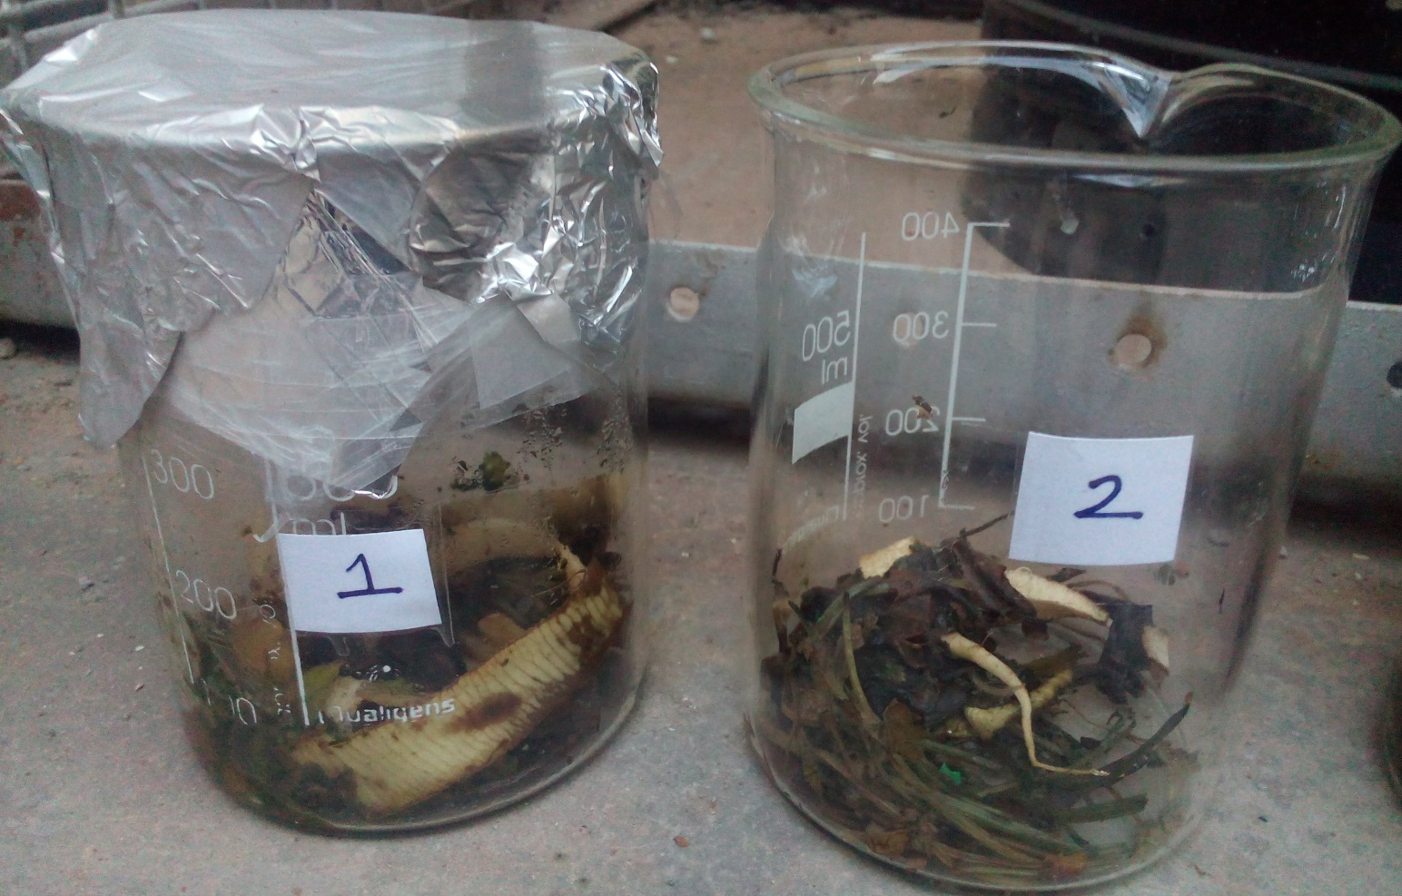
Waste observed after 7 days of inoculation of CDB1:

Slide 15
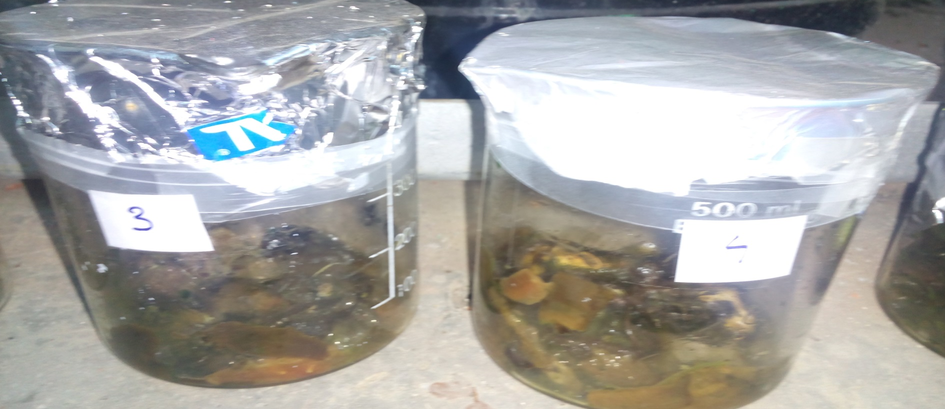
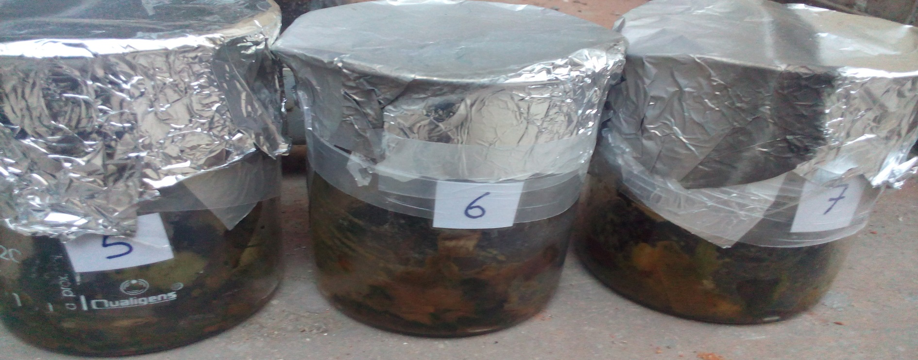

Slide 16
THANKYOU

